Slide 1

Continuous Performance Engineering
HowTo
Henrik Ingo
Fosdem 2026

Slide 2
Continuous Benchmarking
HowTo
Henrik Ingo
Fosdem 2026

Slide 3
POLL
We don’t really do benchmarking
Benchmarks yes, continuous no
Some benchmarks run in CI
…but we ignore the results
Benchmarks in CI,
Daily or more often,
Actionable results,
Regressions fixed within weeks
Continuous Performance Engineering
maturity levels

Slide 4
Continuous Integration
Continuous TESTING
Continuous DEPLOYMENT
DEVOPS
LEFT SHIFTING
ITERATIONS

Slide 5
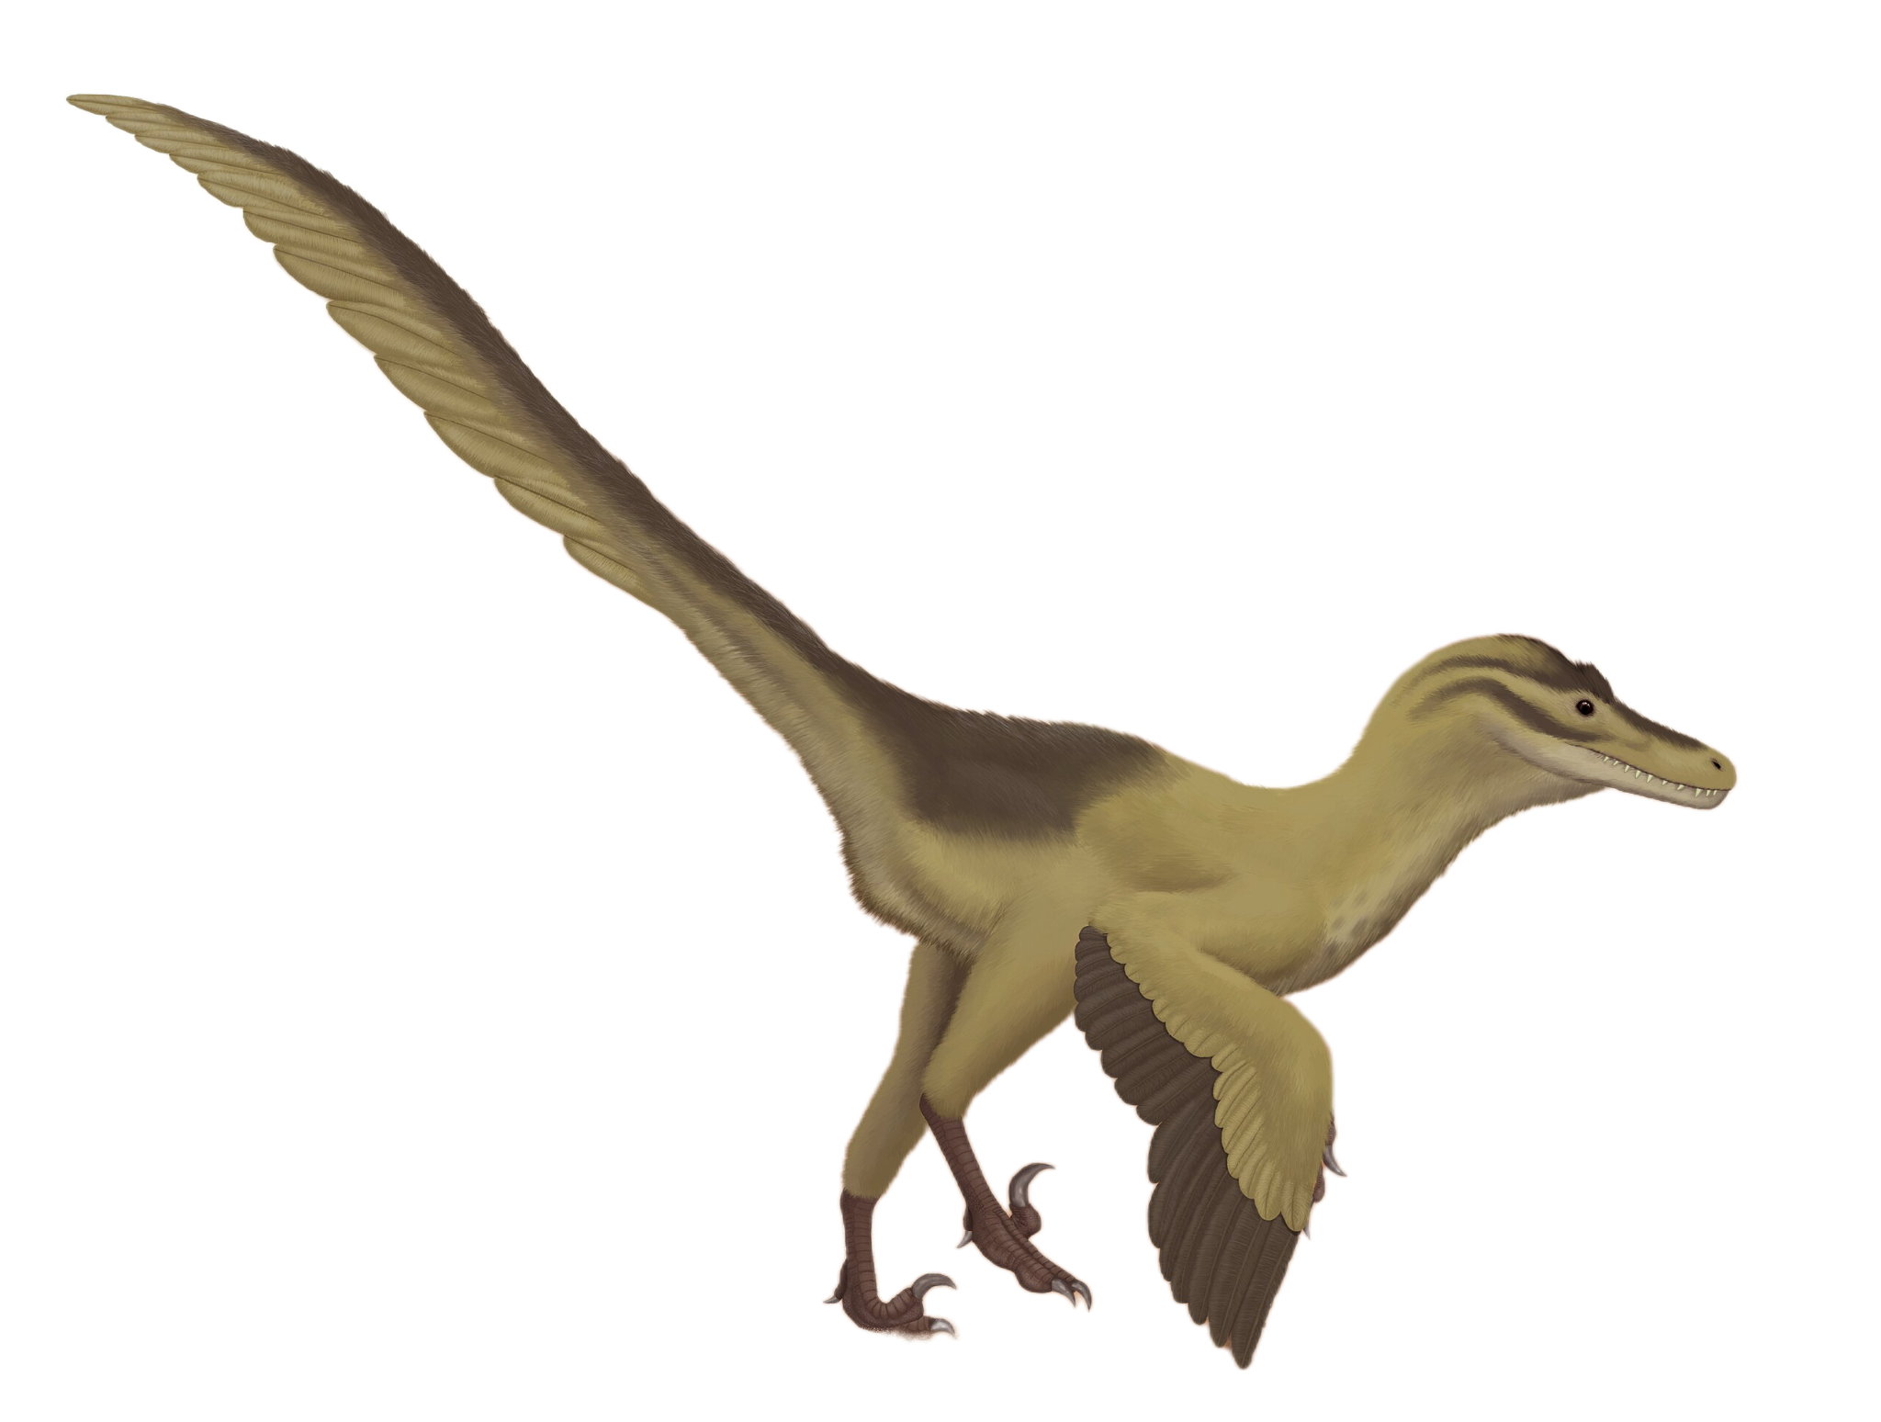
Continuous Performance Engineering?
Somewhere in that evolution, they forgot to bring the performance engineer
Velociraptor, the fastest dinosaur (wikipedia)

Slide 6
WHY was Performance Engineering Left in 1999?
Deploying is necessary - benchmarking is optional
Performance Engineers busy fixing prod / customer problems
….and maybe enjoying it?
Math is hard
Relevant tuning is unintuitive, not well known

Slide 7
I will tell you how .
If you promise
Tell everyone else? .

Slide 8
Agenda
Benchmarking
Make it Continuous
Change Point Detection
Math & Science
Minimizing noise in the Benchmarks
Assume nothing.
Measure everything.

Slide 9
Benchmarking Process and Tools

Slide 10
On Benchmark tools & Design
Previous talk by Kemal Akkoyun & Augusto de Oliveira.
But in general…
at this point each language has its own standard framework:
  Java & JMH
  Python & pytest-benchmark
  etc…
Frameworks to run fully, end to end automated distributed benchmarks exist. Personally I believe we will see new innovation coming here. (k8s)

Slide 11
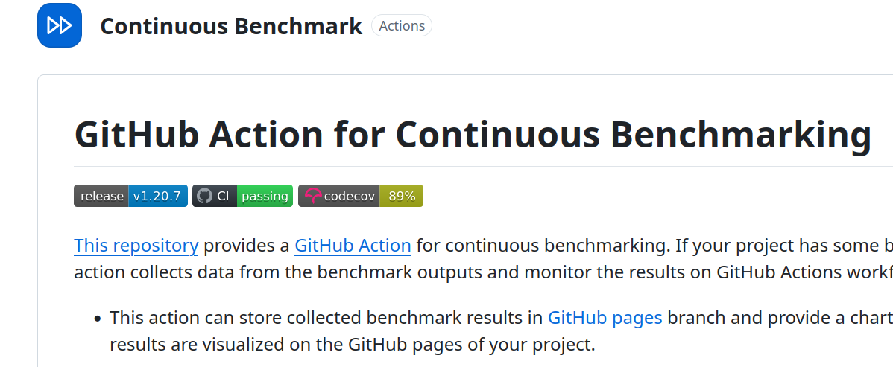
Github-action-benchmark
Use in your workflows immediately after the benchmark step
Supports output from all major frameworks
Stores result history in your github repo.
Threshold based alerts.
Default threshold = 100% (2x)

Slide 12
Change POINT DETECTION

Slide 13
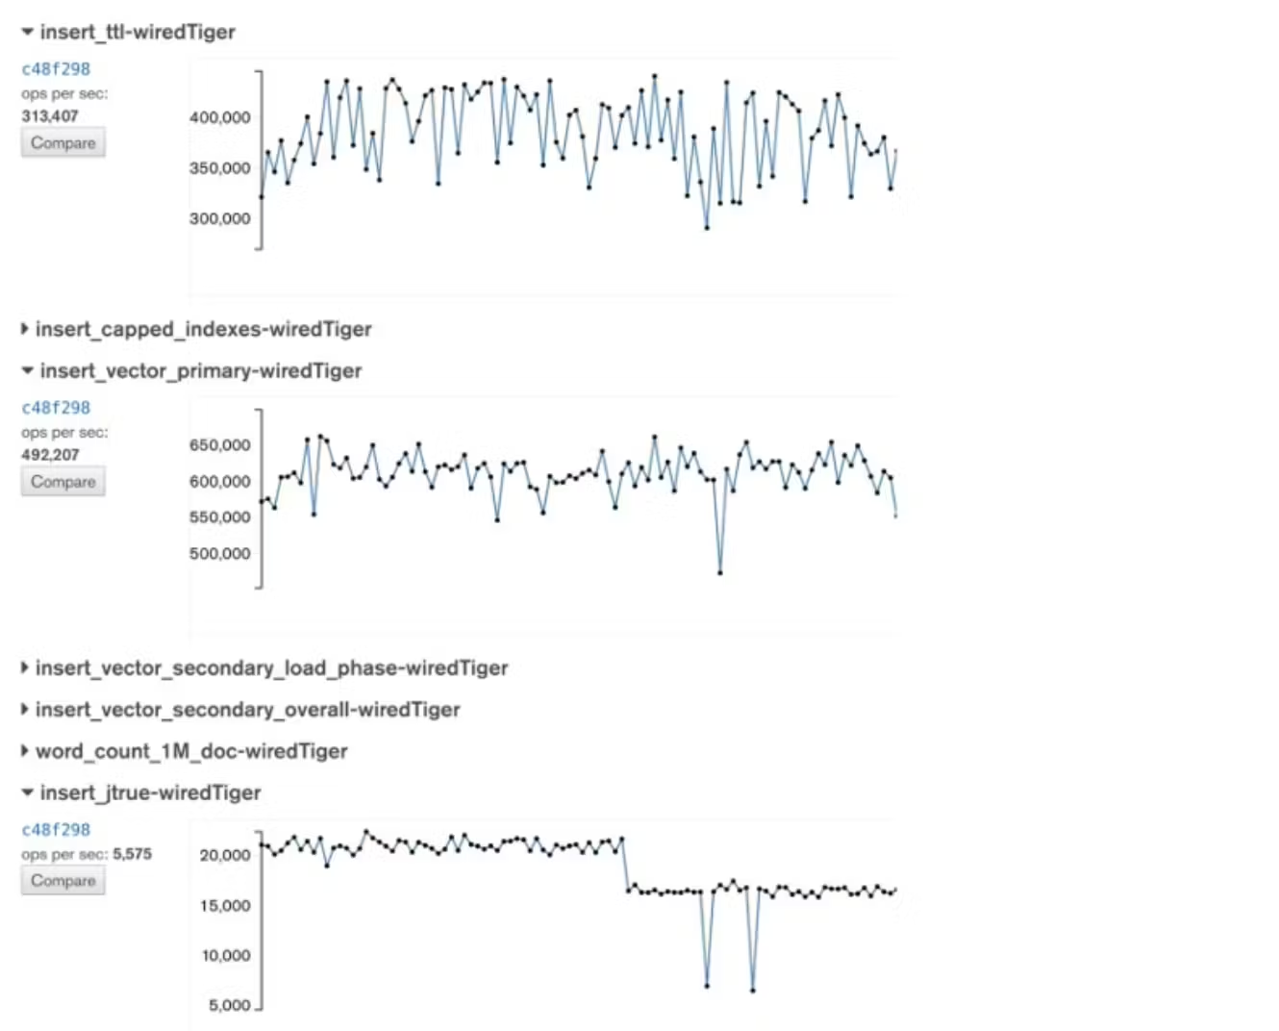

A day in the life of a MongoDB Perf Engineer, 2015.
40 % noise.
No regression!
17 %
No regression!
15 %
No regression!
70%
No regression!

Slide 14
A day in the life of a MongoDB Perf Engineer, 2015.
40 % noise.
No regression!
17 %
No regression!
15 %
No regression!
Regression!
70%
No regression!

Slide 15
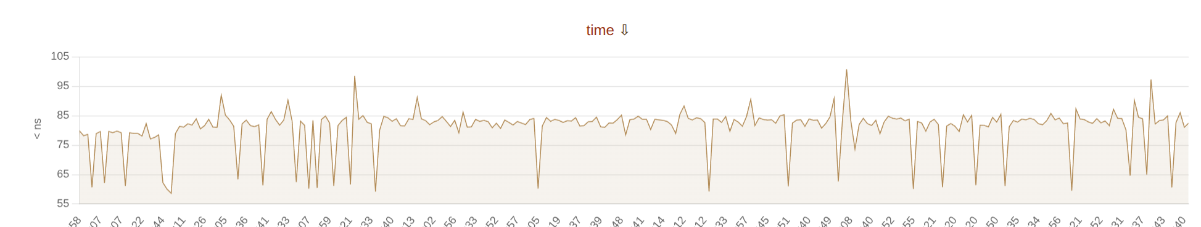
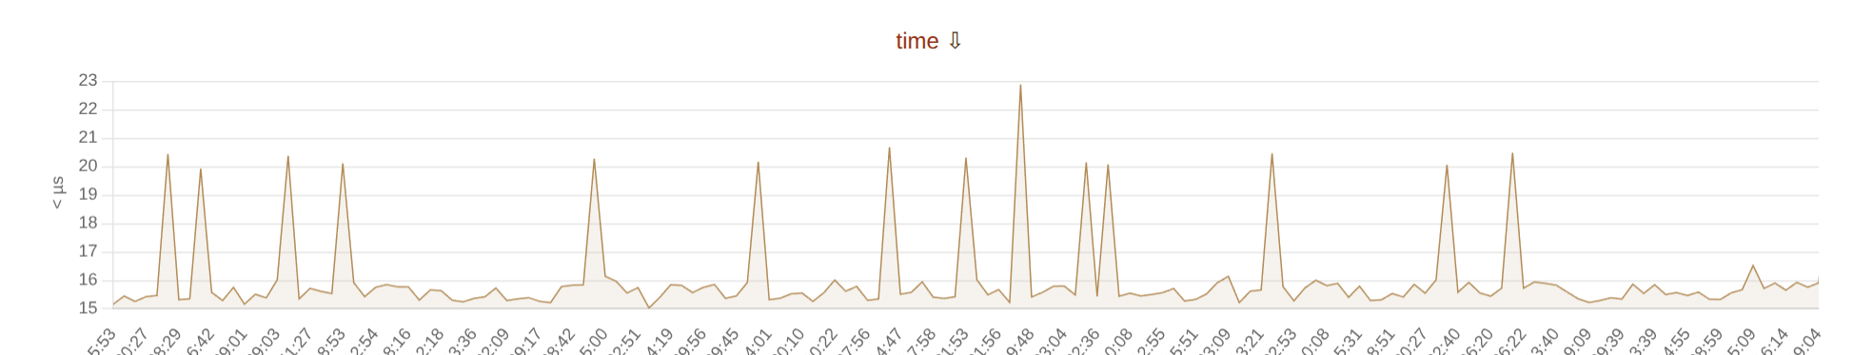
Everyone on GitHub, 2025:
SELECT 1
Range: 60-100 ns (40%)
SELECT COUNT(*)
Range: 15-23 ns (50%)
Turso database, Github runners, on nyrkio.com/public

Slide 16
Automation is one of the core principles…
Threshold based alerting…

Slide 17
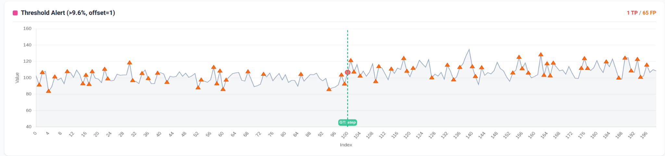
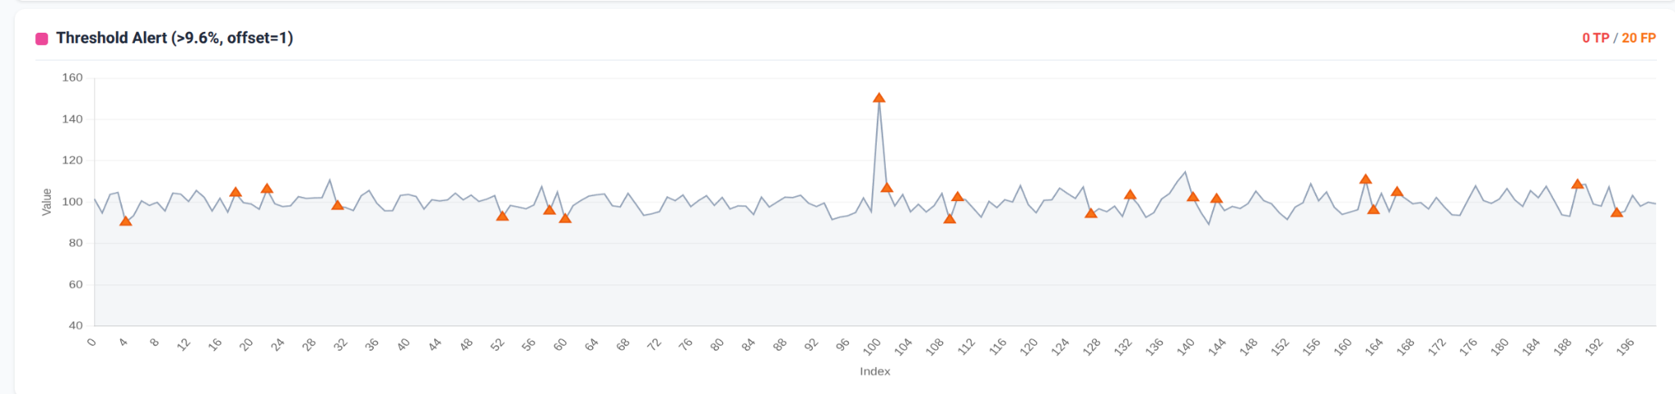

Slide 18
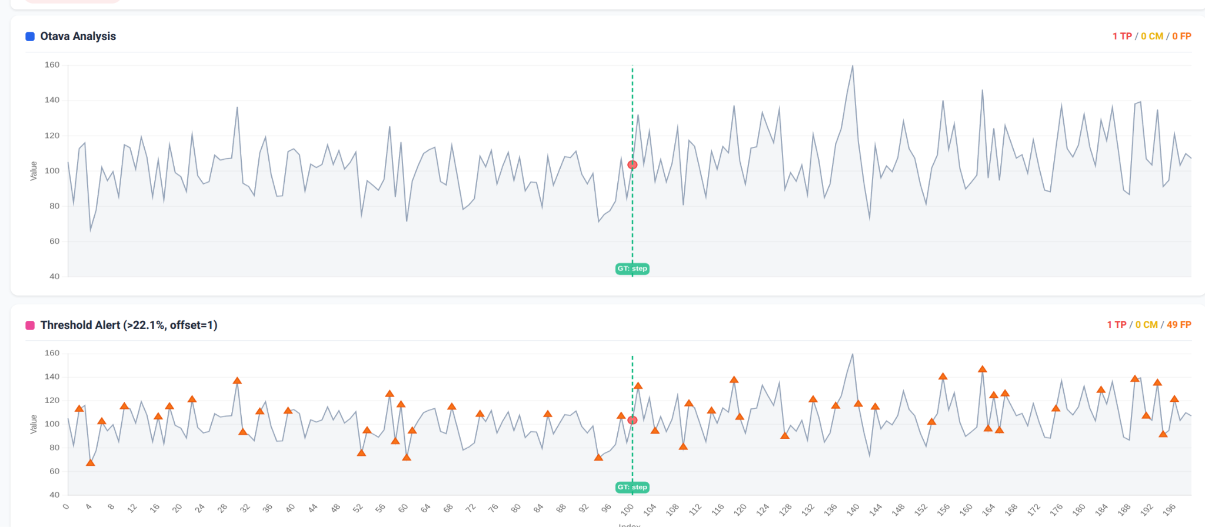
E-Divisive Means (Matteson & James, 2014)
otava.apache.org
Demo app: pip install otava-test-data

Slide 19
otava.apache.org

Slide 20
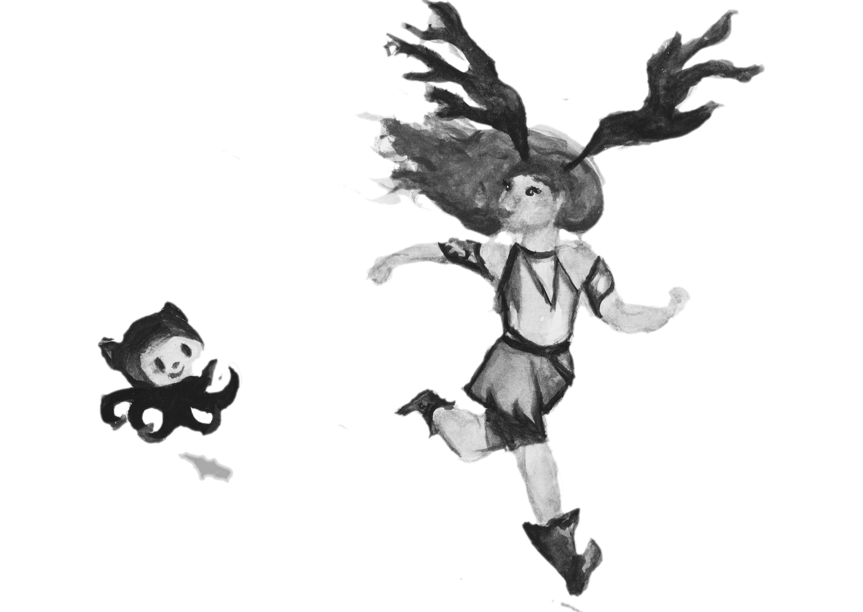
Minimizing noise in benchmarks

Slide 21
Reasons why Benchmark results are so noisy?
CLOUD
CLOUD
NOISY NEIGHBOR
BAD PROGRAMMERS
SOvEReIGN
CLOUD
?

Slide 22
FUN EXeRCISE: ReTROACTIVELY List ASSumptions BUILT INTO YOUR CURRENT ARCHITECTURe
Dedicated instance = more stable performance
Placement groups minimize network latency & variance
Different availability zones have different hardware
For write heavy tests, noise comes from disk
Ephemeral (SSD) disks have least variance
There are good and bad EC2 instances
Just use i2 instances (better SSD)
You can't use cloud for performance testing

Slide 23
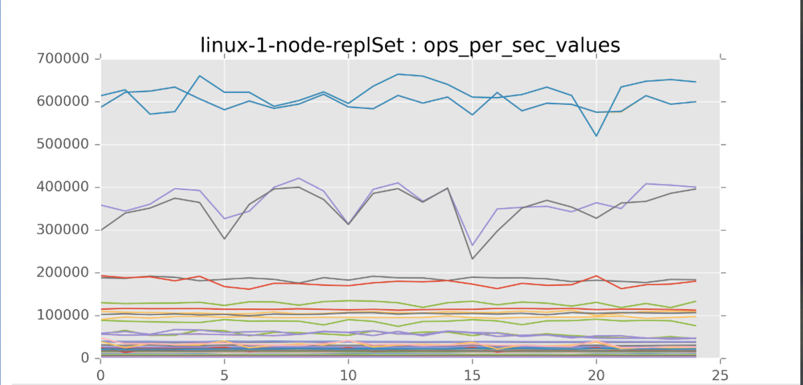
1 MongoDB binary, 5 Servers, repeat tests 5x (2017)

Slide 24
FUN EXeRCISE: ReTROACTIVELY List ASSumptions BUILT INTO YOUR CURRENT ARCHITECTURe
Dedicated instance = more stable performance
Placement groups minimize network latency & variance
Different availability zones have different hardware
For write heavy tests, noise comes from disk
Ephemeral (SSD) disks have least variance
There are good and bad EC2 instances
Just use i2 instances (better SSD)
You can't use cloud for performance testing
False

Slide 25
Was it the neighbors?
Continuous Benchmarking is hard because…
Your hardware is actively working against you:
  CPU Frequency scaling
  CPU boost
  HyperThreading…
  NUMA architecture…
…and that was just the CPU!
Pro Tip: Have you noticed how on EC2 the local SSD disks are not actually called that in AWS documentation.
| man cpupower |

Slide 26
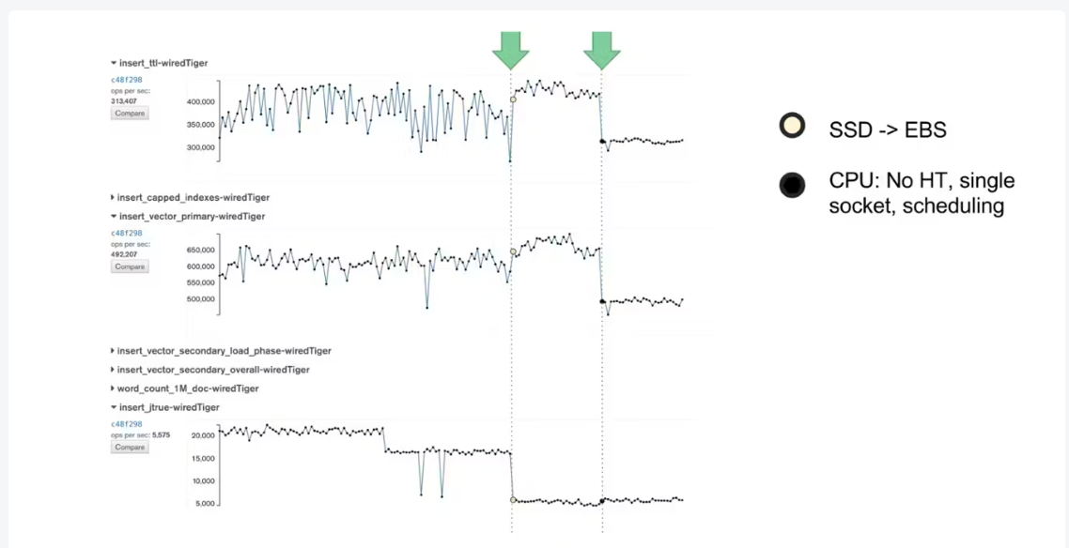
FUN EXeRCISE: ReTROACTIVELY List ASSumptions BUILT INTO YOUR CURRENT ARCHITECTURe
Not tested
Not tested
False, but for C3 family
False, comes all over the place
False, they’re the worst
False (for C3 family)
False (True but Mongo didn’t scale)
False, bare metal same problems
Noise range for all tests: 5%

Slide 27
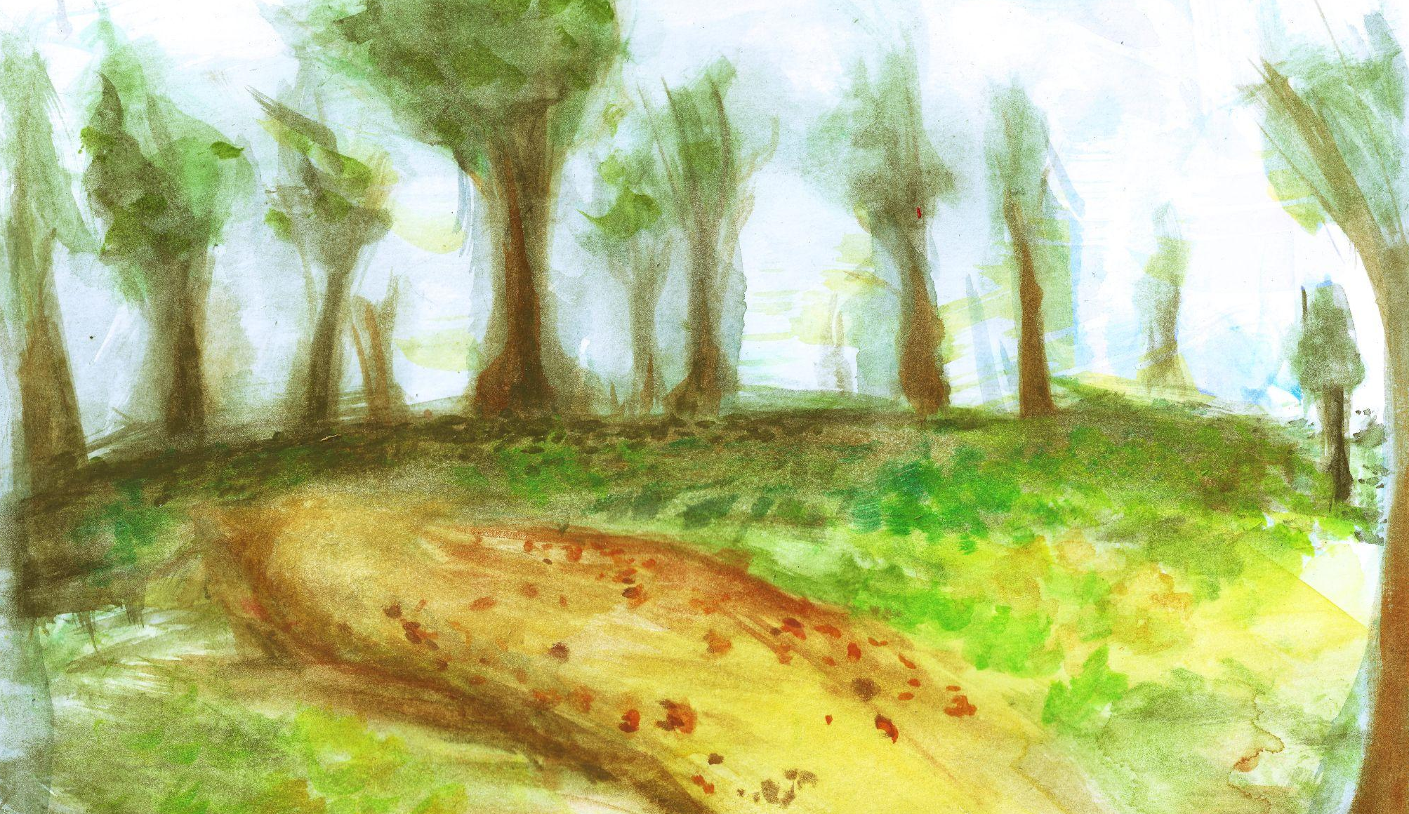

10 years later…

Slide 28
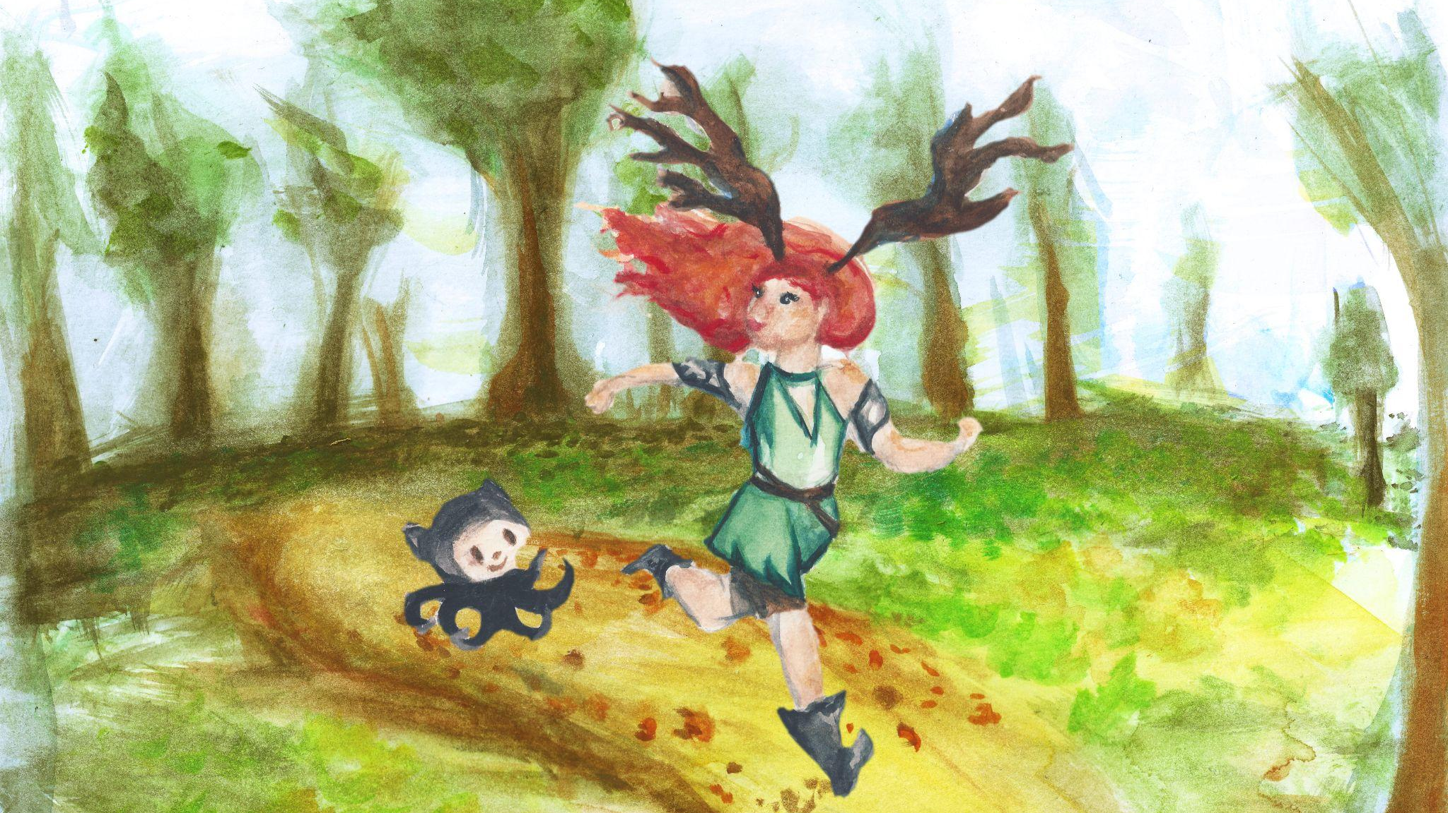

Slide 29
GitHub
Runners
GitHub
Runners

Slide 30
GitHub
Runners
GitHub
Runners
C7a instances
Hand picked &
Carefully tuned
NOT best performance
NOT for price/performance
But
REPEATABLE
performance
Install as GitHub app:
nyrkio.com
Pick a subscription (20 c/h)
In workflow.yml:
| runs-on : nyrkio_2 |

Slide 31
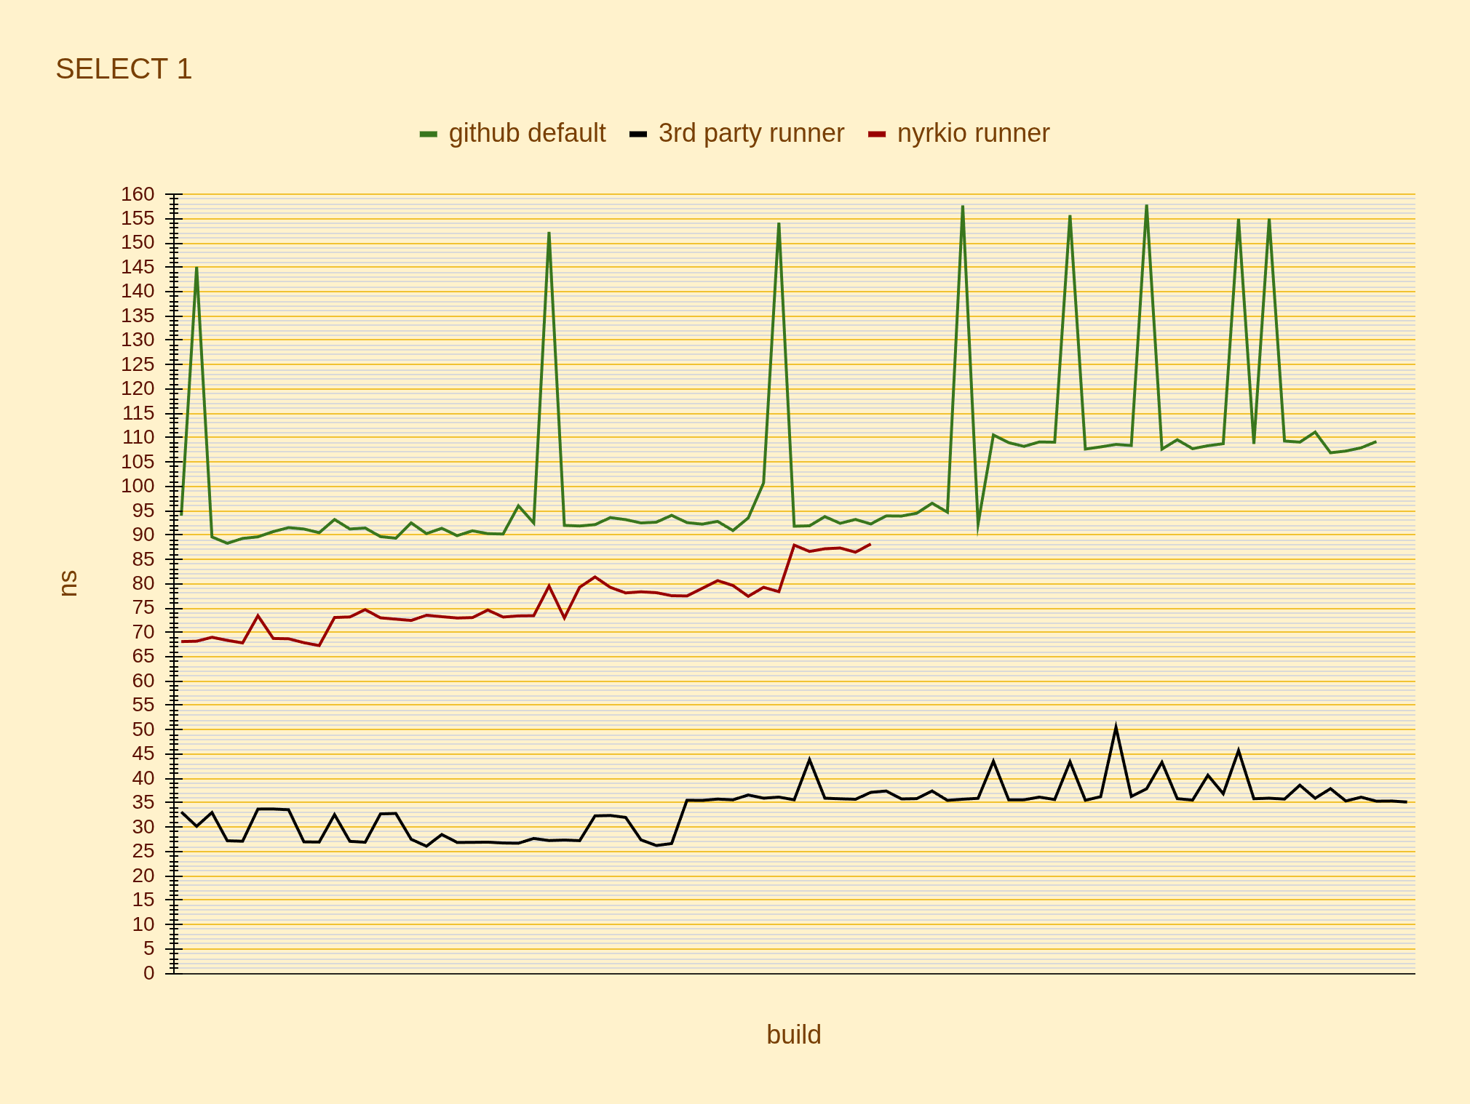
GitHub
Runners
GitHub
Runners
min-max ranges (ns)
github default | 3rd party runner | nyrkio runner
88 | 35 | 73
154 | 51 | 75
66 ns | 15 ns | 2 ns
75% | 44% | 3%

Slide 32
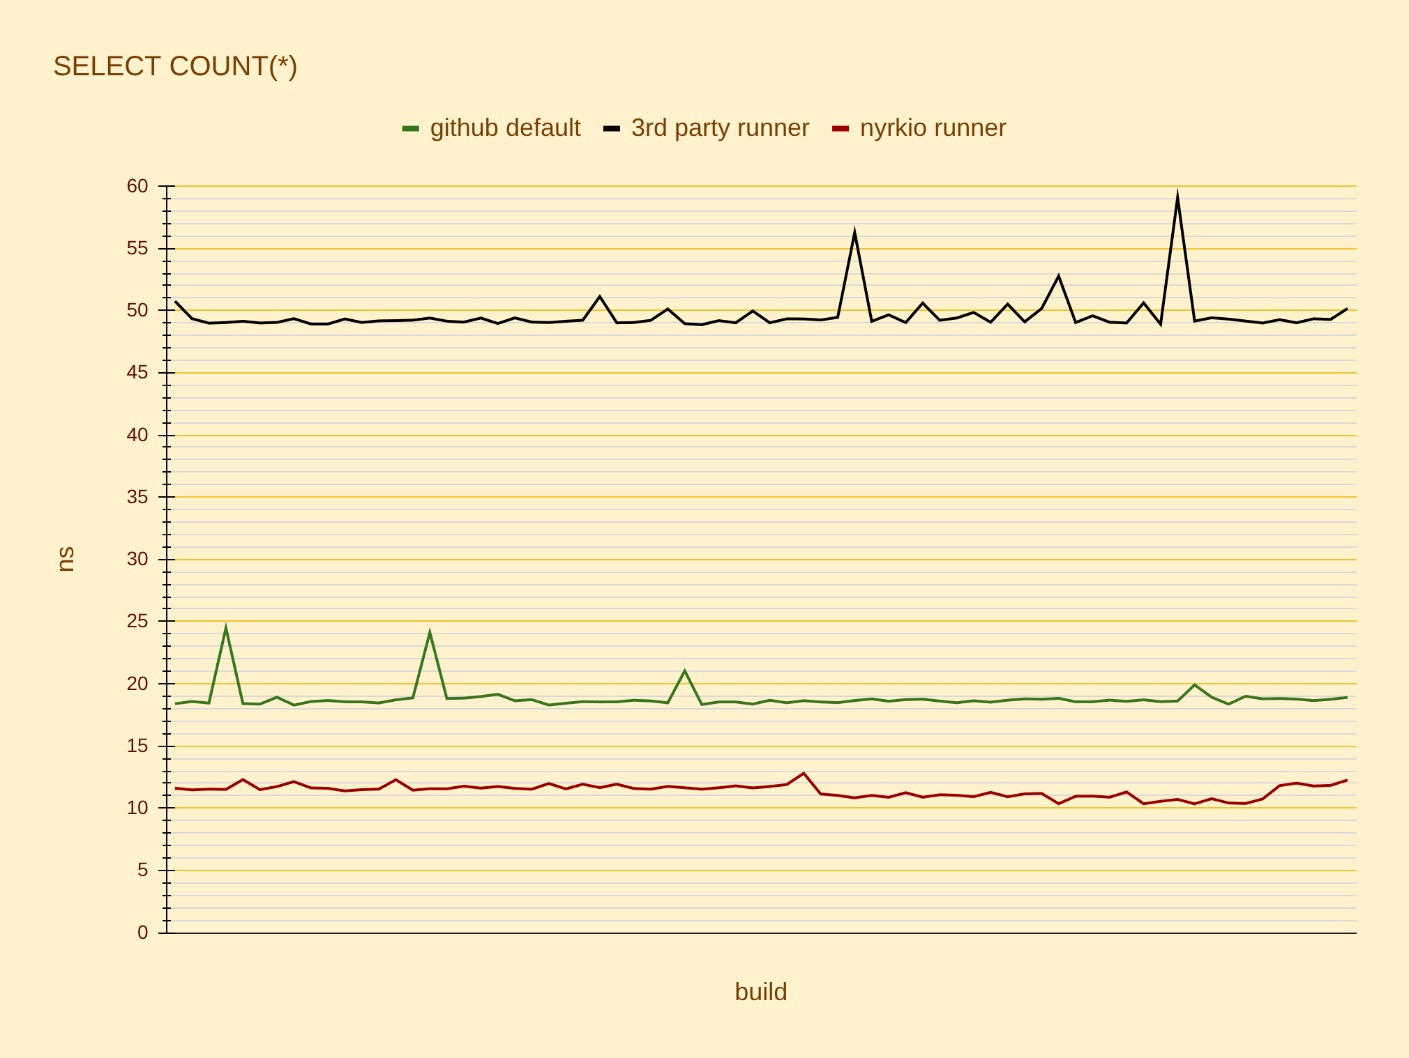
GitHub
Runners
GitHub
Runners
min-max ranges (ns)
github default | 3rd party runner | nyrkio runner
88 | 35 | 73
154 | 51 | 75
66 ns | 15 ns | 2 ns
75% | 44% | 3%
min-max ranges (ns)
github default | 3rd party runner | nyrkio runner
18 | 49 | 11
25 | 59 | 13
6 ns | 10 ns | 1 ns
30% | 21% | 12%

Slide 33
Any difference in 10 years?
C7a family offers high fidelity performance for 100% of the price
No hyperthreading
Single CPU socket
AMD?
Future opportunities:
sub nano-second precision
Dist-sys: Run K8s cluster, on 128 core server
> 4x cheaper

Slide 34
What have we learned?
2.
Apply
Math & Science
… until .
false positives
no longer hurt
1.
Start simple
Benchmark continuously
Performance tuning for repeatable results is
counter intuitive.

Slide 35
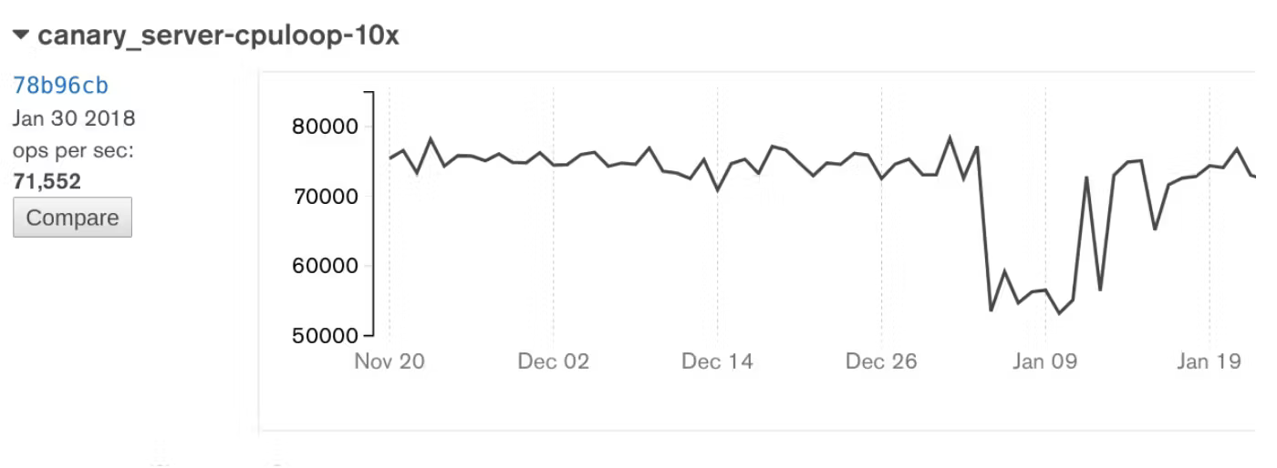
PS: Canaries
Add tests that measure your infrastructure.
CPU
Disk
Network

Slide 36
Credits and references
Ingo,Daly: Reducing Variability in Performance Tests on EC2
www.youtube.com/watch?v=3kHGZ7niHl4
David Daly et.al.: The Use of Change Point Detection to Identify Software Performance Regressions in a Continuous Integration System, 2020.
Fleming & Kołaczkowski: Hunter: Using Change Point Detection to Hunt for Performance Regressions, 2023.
Fixing Performance Regressions Before they Happen (Netflix)
8 Years of Optimizing Apache Otava: How disconnected open source developers took an algorithm from n^3 to constant time
Processor state control for Amazon EC2 Linux instances
Nyyrikki and cat running, watercolor: Ebba Ingo
Velociraptor: Wikimedia commons
Otava test data graphs:
Joe Drumgoole & Claude
Everyone who contributed to Change Detection, now known as Apache Otava (incubating)

